Slide 1

COVARIANCE AND CORRELATION

Slide 2



Covariance and correlation
Covariance is a quantitative measurement of the directional relationship between two continuous variables
Positive covariance means that when one variable increases, the other also increases
Negative covariance means that when one variable increases, the other decreases.
Covariance

Slide 3

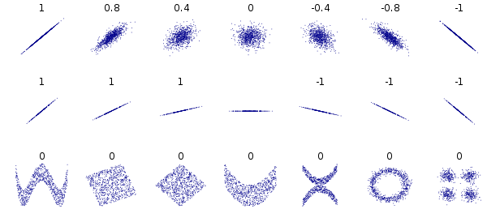
Correlation is a quantitative measurement of how strong is the linear relationship between two numerical variables
Covariance and correlation
Correlation (Pearson)

Slide 4
Covariance and correlation
Correlation measures linear relationship between two numerical variables.
Low correlation doesn’t mean lack of relationship. It can be relationship, but not linear.
Other relationships

Slide 5

Covariance and correlation
Spearman correlation is a quantitative measurement of number of rank ordering agreements and disagreements between two variables. Range = [-1,1]
Correlation (Kendall)

Slide 6

Spearman correlation is a quantitative measurement of how strong is the rank relationship between two variables. Range = [-1,1]
To compute it take the following steps:
Sort the values of both variables from lowest to highest.
For each variable, replace every value by the rank (order, 1 for the highest value, 2 for the second highest, and so on) of the value
Compute the difference in rankings for each pair of both variables
Square the precious differences: D2
Use the formula
Covariance and correlation
Correlation (Spearman)

Slide 7
Covariance and correlation
Use the Panda’s method: corr(method=) where the keyword “method” can be:
‘pearson’
‘spearman’
‘kedall’
Computing all those things

Slide 8
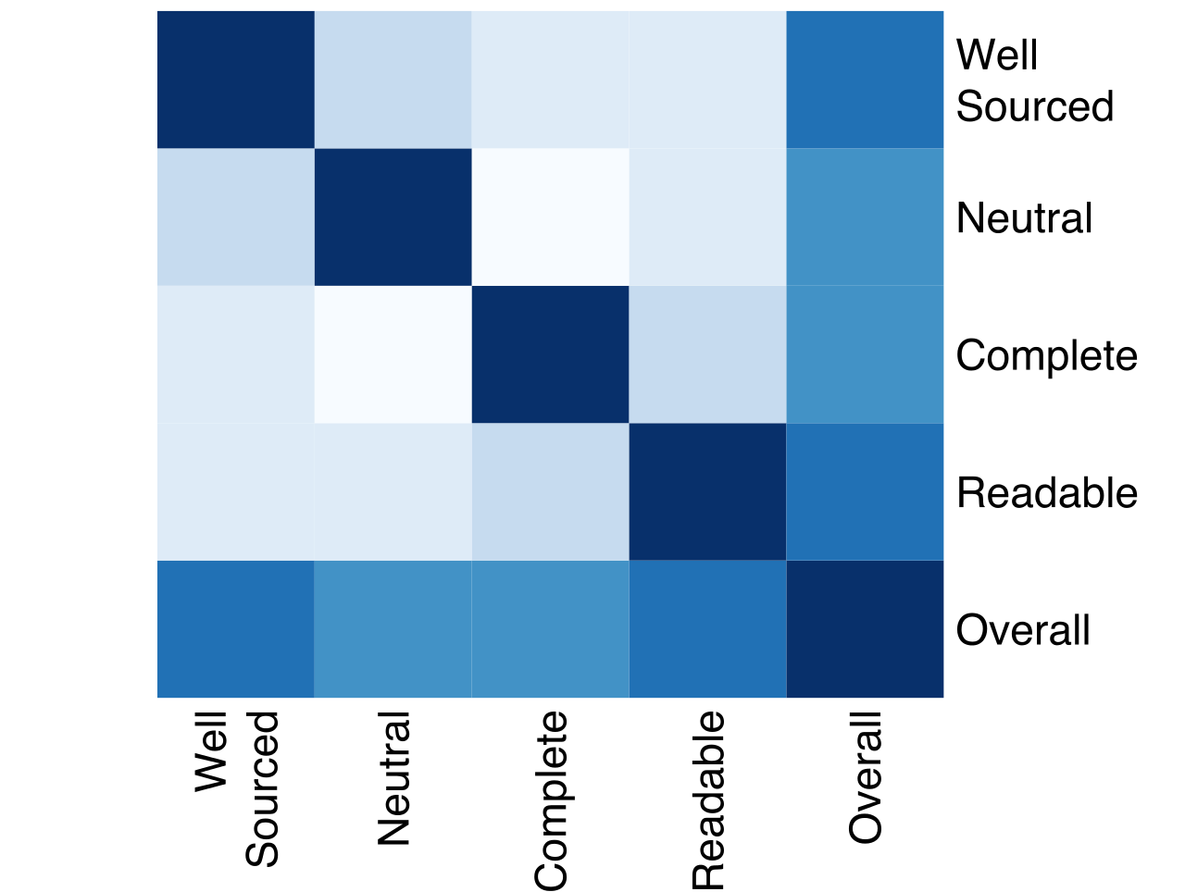
Covariance and correlation
A heatmap is a plot which display a matrix of floats with a color scale.
To plot a heatmap use the following approach:
fig, ax = plt.subplots(figsize=(10, 8))
corr_matrix = df.corr()
ax = sns.heatmap(corr_matrix, mask=mask, annot=True)
plt.show()
https://seaborn.pydata.org/generated/seaborn.heatmap.html
Heatmap

